Slide 1

Project report

Slide 2

A presentation on
python tic tac toe game
Submitted To :
ED APPLY PVT.LTD
Submitted BY :
CHIRAG JAIN
AVIK JAIN
RAJAT JAKHAR

Slide 3

INTRODUCTION
Tic-tac-toe (or Noughts and crosses, Xs and Os) is a pencil-and-paper game for two players, X and O, who take turns marking the spaces in a 3×3 grid. The player who succeeds in placing three respective marks in a horizontal, vertical, or diagonal row wins the game. Players soon discover that best play from both parties leads to a draw (often referred to as cat or cat's game). Hence, Tic-tac-toe is most often played by young children. The friendliness of Tic-tac-toe games makes them ideal as a pedagogical tool for teaching the concepts of good sportsmanship and the branch of artificial intelligence that deals with the searching of game trees. It is straightforward to write a computer program to play Tic-tac-toe perfectly, to enumerate the 765 essentially different positions (the state space complexity), or the 26,830 possible games up to rotations and reflections (the game tree complexity) on this space.

Slide 4
INTRODUCTION
Sometimes we want the computer to select a random number in a given range we use random library in python
Steps:-
First step we need to import the random library.
Second step we need to create a function name drawboard(board).This function is used to print out the board that it was passed board is a list of 10 strings representing the board.
Third step is to create a function name inputplayerletter().This function is used to choose which letter they want to choose “x” or “o”.
Fourth step is used to create a function name whogoesfirst(). This function is used to choose who goes first.
Fifth step is used to create a function name playagain(). This function is used to return true if player wants to play again otherwise return false.
Sixth step is to create a function name is winner(). This function is used to print who is the winner computer or the user.

Slide 5
INTRODUCTION
Seven step is to create a function name is getboardcopy().This function is to create a duplicate of the list and return its duplicate.
Eight step is to create a function name is isSpacefree().This function is to print true if the move is passed otherwise print false.
Ninth step is to create a function name is getplayermove().This function is to help to choose the in between the range(1-9) otherwise it does not passed the move.
Tenth step is to create a function name is chooserandommovefromlist().This function is used to written valid ifn the move is valid and written invalid if the move is invalid.
Eleventh step is to create a function name is getcomputermove().This function is used to determine where the move is and passed there.
Twelfth step is to create a loop using for loop to check if the player could win on the next move .
Thirteen step is to create a function name is isboardfull().This is to return true if space on the board has taken otherwise return false.
Fourteen step is to create a true while loop to print the winner and to ask to play again or not.

Slide 6

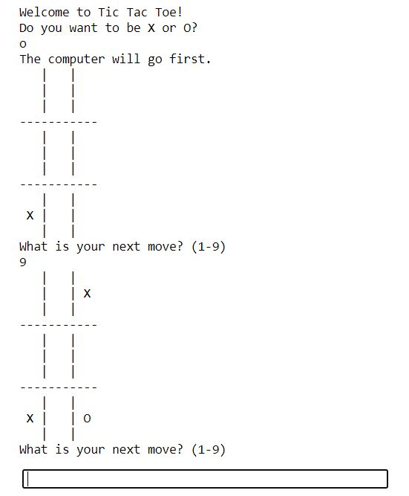
SCREENSHORT ON RUN TIME

Slide 7

Thank You

